Slide 1


Discover Erasmus+ programme’s project
«Restarting adult learning skills through new teaching methods»
No.2018-1-LV01-KA201-046972
Adult ReStart

Slide 2

Learning is lifelong journey!
Nowadays IT plays important role in study process and activities together with teacher interaction with students and methods used for teaching, therefore educators should know latest trends in ICT usage and know how to use/adopt them effectively daily. Students have to understand and be able to learn through new approach, they have to adapt. Both students and teachers have to get explanation and proper training before they start to use new tools and methods. This is the story of the project.

Slide 3
Goal
Restarting adult learning skills through new teaching methods
a 13 month project (01.10.2018.–31.10.2019.), co-funded
by the European Commission under the Erasmus+ programme
The aim of the Project is to form a strong European network of 3 educational institutions, which are experienced in ICT and provides opportunity for adults to study at school in order to explore, develop and share methodological materials for distance learning, to structure the teachers work by using different privileges offered by IT in order to promote the system of work with adult students, acquiring new methods for individualized approach, through:
find joint solutions that add value to all project partners and lead to joint positive results. Having sustainable development in terms of networking and activities, plans and strategic issues that cooperation offers.
exchange of good and innovative practice to improve/promote the knowledge & professional skills, competencies of teachers and provide training
in order to:

Slide 4
Objectives
Exchange good practises to develop the acquisition of teacher skills and competencies and improve teacher knowledge of distance learning methodology and usage of IT in learning process
Improve the integration of ICT in teaching and education process. Learn new tools to promote digital learning
Share innovative methods of teaching for increasing attractiveness of education methods
Develop educational material

Slide 5
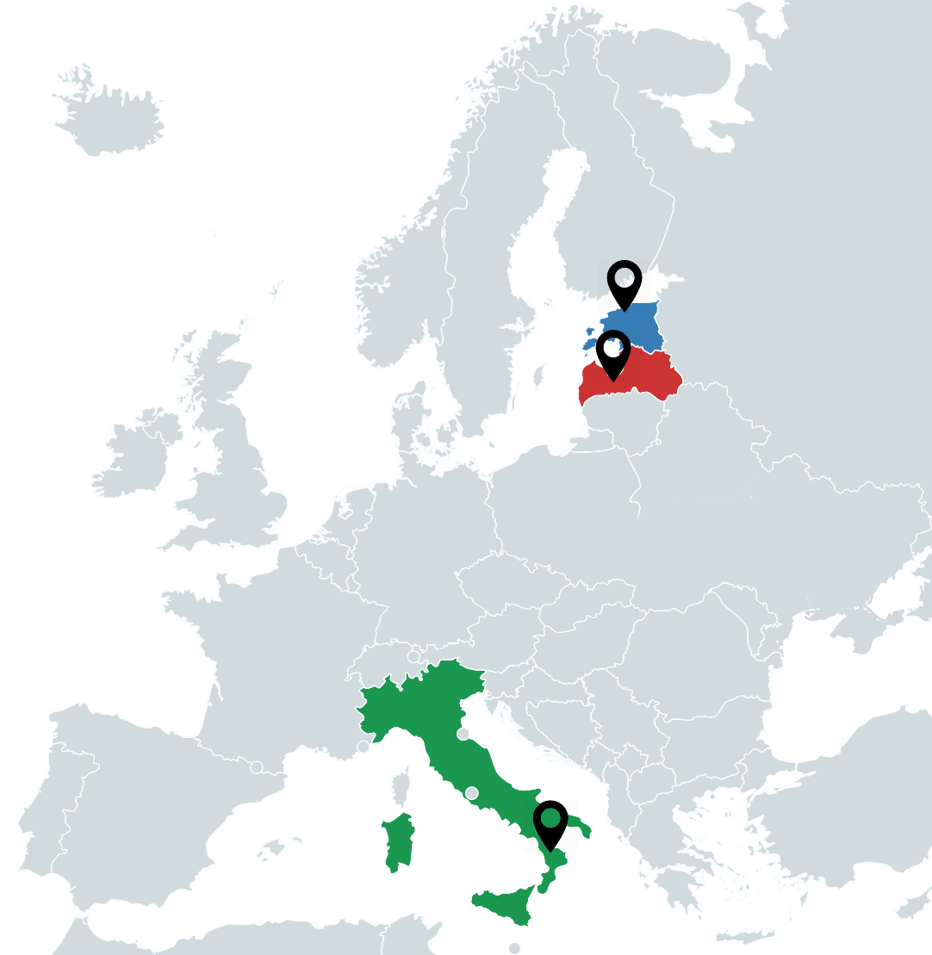
Partnership
The Project is implemented by a network of three partners from 3 European Countries
Latvia
Jelgava District Correspondence School
Estonia
Tallinn Upper Secondary School for Adults
Italy
Futuro Digitale

Slide 6



Partnership composition
Correspondence school | Upper Secondary School | NGO
Jelgava Local Municipality Correspondence School (Jelgavas novada Neklātienes vidusskola) www.nvsk.lv | Tallinn Upper Secondary School for Adults (Tallinna Täiskasvanute Gümnaasium) www.tg.edu.ee | Futuro Digitale (Associazione di Promozione Sociale Futuro Digitale) www.futurodigitale.org
Jelgava, Latvia | Tallinn, Estonia | Terranova da Sibari, Italy

Slide 7
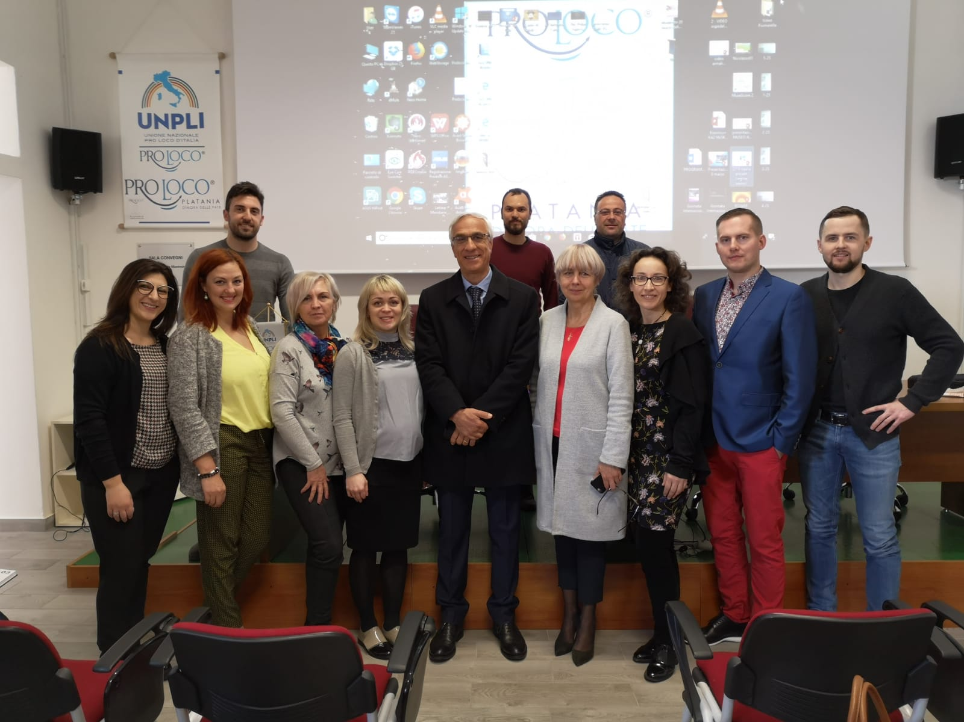
Target group
The project addresses different target groups at local, national and European level:
Educational institutions for adult learners
Adult learners
Teachers, educators, trainers
E-learners
Educational institution staff
IT specialists

Slide 8
Activities
Management | Activities | Dissemination | Results
Financial agreement Finances Work group LP & PP roles, tasks, responsibilities Workplan Communication tools Documents Final report Sustainability | Kick-off meeting, LV Research about distance learning studies using IT Edurio questionnaire Language training Learning activity, IT Local learning activities for staff Local meetings LP, PP Knowledge approbation, local e-learning system Educational material Online meetings Publications Final meetings Reporting | File sharing platform Dissemination plan Evidence compilation file Erasmus+ result platform Epale, School Education Gateway, eTwinning Local media, organisation’s webpage, social networks, etc. Pedagogically methodical meetings Staff & learner’s meetings Job shadowing (visiting) Seminars, conferences | Network of 3 partners 3 seperate questionnaires about distance learning – LV, EE, IT Research on distance learning studies using IT Adult learners took part in survey Improved teacher skills – language, IT, new tools, methods Methodological Material for Adult Education in Distance Learning – 4 languages Promotion of adult education New ICT tools (e.g. Big Blue Button)

Slide 9
Activities
Research (survey) | Training | Educational material
3 seperate questionnaires Edurio system as a platform In total 197 adult learners (LV-72, EE-85, IT-40) Survey summary - Research on distance learning studies using IT Similar learning platforms (Moodle)+AltereduAcademy Need of development and diversity of learning materials & subjects Need of toolkit/guidelines for adults about how to use/learn in distance learning system Recommendations from adult learners Similar case situation in EE & LV | Short term joint staff training activity March 25-29, 2019. Lamezia Terme, Italy 10 participants (EE-3, LV-4, IT3) 7 out of 10 – first Erasmus+ experiance Learning activities, expert presentations, discussions, workshops, practical tasks Certification (Certificate + Europass Mobility document) Gained knowledge and skills used for development of educational material | Methodological Material for Adult Education in Distance Learning Compilation of information and recommendations for a more successful adult education in the Moodle distance learning environment 38 pages, 4 languages (English, Latvian, Estonian, Italian) Locally trained educators to work with the new material Adult learners as users Improved adult learning methods More opportunities to work in e-environment Future developments and improved methods ICT tools

Slide 10
Added value
Well functioning network with 3 EU partners in adult education
Established cooperation contacts to develop and improve adult learning methods
European dimension recognition
Improved attractiveness of educational methods
Development of distance learning management
Methods could be used both - inside and outside the network
More flexible studies and open education by implementing better use of ICT
Methodological material for better use of distance learning environment using various IT tools
Improved Moodle environment
Teachers trained to work with new features, tools and methods
Improved project participants skills and abilities
Capability of sharing know-how
It is anticipated to have less student drop-outs
Opportunity to choose methods and forms in education work
Positive impact on teachers and adult learners
New ideas for future developments in distance learning methods and ICT tools
Foreseen tasks/recommendations for continuing development of adult education

Slide 11
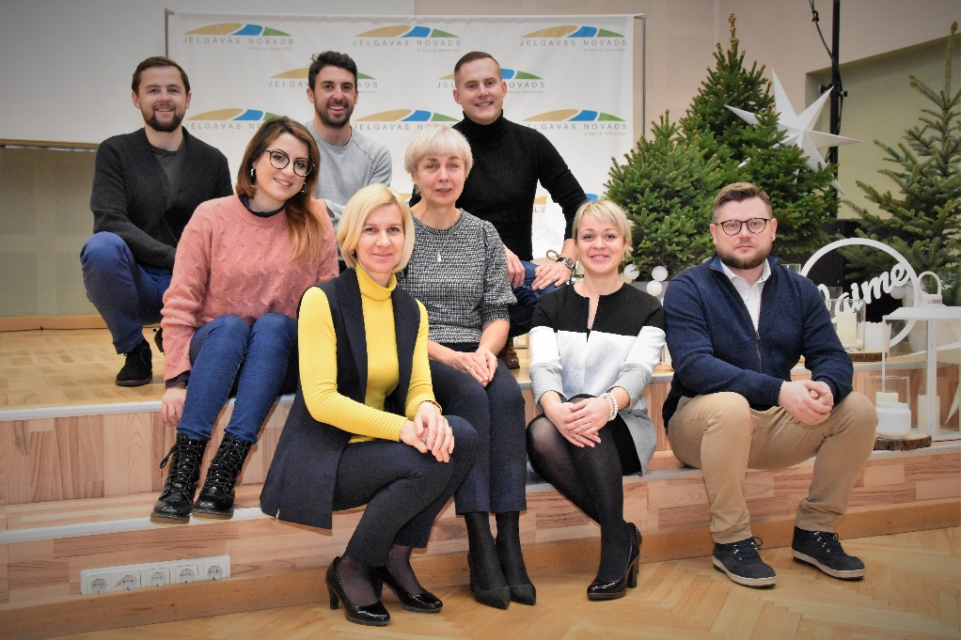
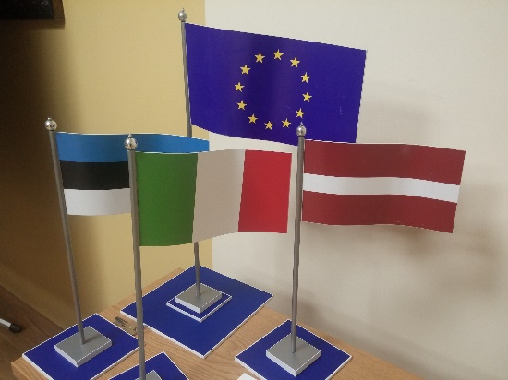
Project contacts
Jelgavas novada Neklātienes vidusskola (Latvija)
Director Irma Sermūksle, nvsk@jelgavasnovads.lv
Contact person Inga Eihentāle, inga.eihentale@jelgavasnovads.lv
Tallinna Täiskasvanute Gümnaasium (Eesti)
Director Heiki Kiidli, direktor@tg.edu.ee
Contact person Egert Klaas, vkool@tg.edu.ee
Associazione di Promozione Sociale Futuro Digitale (Italia)
President Antonio Gallo, info@futurodigitale.org
Contact person Antonio Pullia, a.pullia@futurodigitale.org
Info at Erasmus+ Result Platform: HERE

